Slide 1
Detect and Highlight entities from unstructured text using machine learning
INT161
Komal Narsinghani, SAP

Slide 2
Disclaimer
The information in this presentation is confidential and proprietary to SAP and may not be disclosed without the permission of SAP. Except for your obligation to protect confidential information, this presentation is not subject to your license agreement or any other service or subscription agreement with SAP. SAP has no obligation to pursue any course of business outlined in this presentation or any related document, or to develop or release any functionality mentioned therein.
This presentation, or any related document and SAP's strategy and possible future developments, products and or platforms directions and functionality are all subject to change and may be changed by SAP at any time for any reason without notice. The information in this presentation is not a commitment, promise or legal obligation to deliver any material, code or functionality. This presentation is provided without a warranty of any kind, either express or implied, including but not limited to, the implied warranties of merchantability, fitness for a particular purpose, or non-infringement. This presentation is for informational purposes and may not be incorporated into a contract. SAP assumes no responsibility for errors or omissions in this presentation, except if such damages were caused by SAP’s intentional or gross negligence.
All forward-looking statements are subject to various risks and uncertainties that could cause actual results to differ materially from expectations. Readers are cautioned not to place undue reliance on these forward-looking statements, which speak only as of their dates, and they should not be relied upon in making purchasing decisions.

Slide 3
Agenda
Overview
What is Business Entity Recognition
Use-cases
Explore various use-cases and applications of Business Entity Recognition
Technical Overview
Architecture, APIs and Machine Learning process
Demo
A demo showing Business Entity Recognition in action

Slide 4
What is Business Entity Recognition?

Slide 5







Business Entity Recognition (BER) Detect and highlight any given type of named entity in unstructured text
Text Document for Entity Extraction
Pre trained/Custom Entity Recognition model for Text
Automatically recognize entities in text document
Powerful machine learning technology to detect and highlight any given type of
named entity in unstructured text into pre-defined categories
Increase efficiency and reduce errors
Immediately Productive with Pre-Trained models
Increase overall document processing productivity​

Slide 6
Business Entity Recognition: Use-cases

Slide 7






Locating and Classifying Named Entities in Unstructured Text Moments of truth
The average office worker receives 121 emails and sends about 40 each day.
Employees spend 20 mins on average to complete one expense report.
Notes:
Studies show that an average office worker receives 121 emails daily and sends about 40 emails daily.
Also employees spend an average of 20min on completing one single expense report with 19% of the expense reports having errors and another 18min spent on average to correct those errors.
Those are two statistics that at first glance might look very unconnected.
But there is one thing they have in common: it is that employees spent a huge amount of time on them.
Looking through all the emails received per day, having to filter out the really important emails from the newsletters, deciding on which email to answer first and then ultimately answering to it, is a time consuming task for employees.
Also filing expense reports is usually really time consuming, having to add all the trip details and then also having to copy all the details from each and every bill received on the trip
In this session I want to explain how both of the scenarios can be simplified by automation with “Business Entity Recognition”
Let’s start with having a look at the emails
Source 2: https://www.gbta.org/blog/how-much-do-expense-reports-really-cost-a-company/

Slide 8

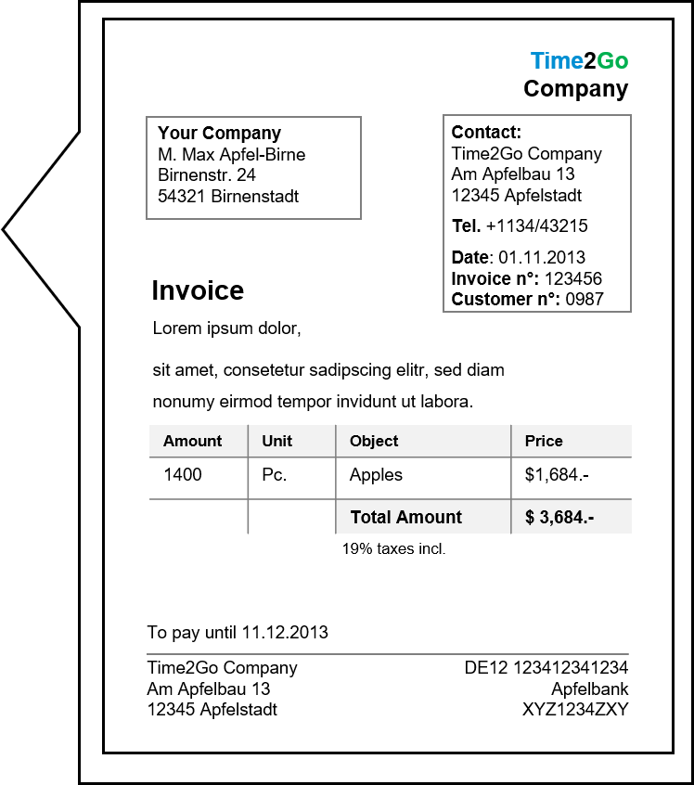
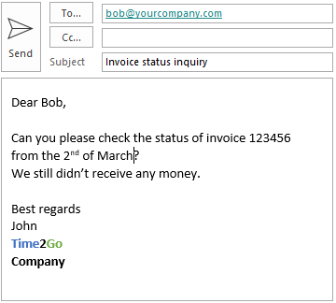






Locating and Classifying Named Entities in Unstructured Text Problem: long time to understand the context of emails and processing them
Subject: Question to my order
From: john.travolta@mail.com
To: customerservice@shop.com
5-15 minutes per ticket
Dear Customer Agent,
I placed an order on 03rd March 2020 and still have not received it. Could you please tell me when it will arrive? My customer number is 123456 and my order number is 321456.
Thank you & best regards,
John
Create customer ticket
Bob spends much time on understanding the email context and providing the answer to the request
Research and processing in different systems
Bob, Customer Service
Notes:
Let’s imagine the following situation
Bob is a customer service agent
His job is to answer to customer tickets such as questions, complaints and inquiries
He for example receives emails from customers that have ordered products from his company and have not received them yet
Customers like this would like to know when their order will be shipped to them
For answering this inquiry Bob has to look at the email, read through it and extract needed information, such as the customer number and order number
Bob has to create a customer ticket for the email that came in
He then has to access one or several systems in order to find out the status of the order

Slide 9



Locating and Classifying Named Entities in Unstructured Text Solution: Business Entity Recognition
Customer # | 123456
Order # | 321456
Date | 03.03.2020
Subject: Question to my order
Business Entity Recognition
From: john.travolta@mail.com
To: customerservice@shop.com
Dear Customer Agent,
I placed an order on 03rd March 2020 and still have not received it. Could you please tell me when it will arrive? My customer number is 123456 and my order number is 321456.
Thank you & best regards,
John
Possibility for automated research & processing in various systems
Create customer ticket
Bob can now provide a faster response and use his time for value-creating tasks
Bob, Customer Service
Notes:
With the help of “Business Entity Recognition” Bob can receive important information automatically
“Business Entity Recognition” can extract named entities from the received email
Those entities can then be directly displayed to the customer service agent so that he can process the inquiry faster
Additionally the automated extraction also provides a possibility for processing the extracted information automated too

Slide 10



Locating and Classifying Named Entities in Unstructured Text Shared Services Framework
Shared Service Framework
Incoming message
Service Ticket Intelligence
Business Entity Recognition
Responsible department
Solution provided quickly
or
Email
Service Agents
IRPA Bot
Ticket
Processing
Recognition of predefined entities
Including free text
Classification
Further communication with sender
Higher service quality
Using synergies of various SAP AI Business Services & applications
Notes:
Another use case I want to talk about can be found in the area of a shared service framework
Such a shared service framework can for example be a financial shared service center which takes care of supplier requests, complaints and inquiries
The suppliers write an email or open a ticket in which they describe their situation
For example a supplier could send an email in which he asks for the payment status of the invoice he has issues with the invoice number 54321
When the ticket comes in first the service “Service Ticket Intelligence” is used to categorize what kind of ticket it is
In our example it would maybe have the category “invoice inquiry”
Afterwards the “Business Entity Recognition” service is used to identify relevant entities such as the supplier and the invoice ID
Then the use case can be enhanced with “SAP Intelligent Robotic Process Automation”
An IRPA bot could pick up easier inquiries such as the one about the status of the invoice payment
The bot can then go to the system, look up the invoice payment status and answer the supplier fully automated without any human interaction
Of course if you would like to double check the result in the end or you do not want to use a bot the process can also be continued by a service agent
Automating supplier invoices as described leads to faster processing and solving of incoming requests and inquiries and improves service quality

Slide 11
Business Entity Recognition: Technical Overview

Slide 12
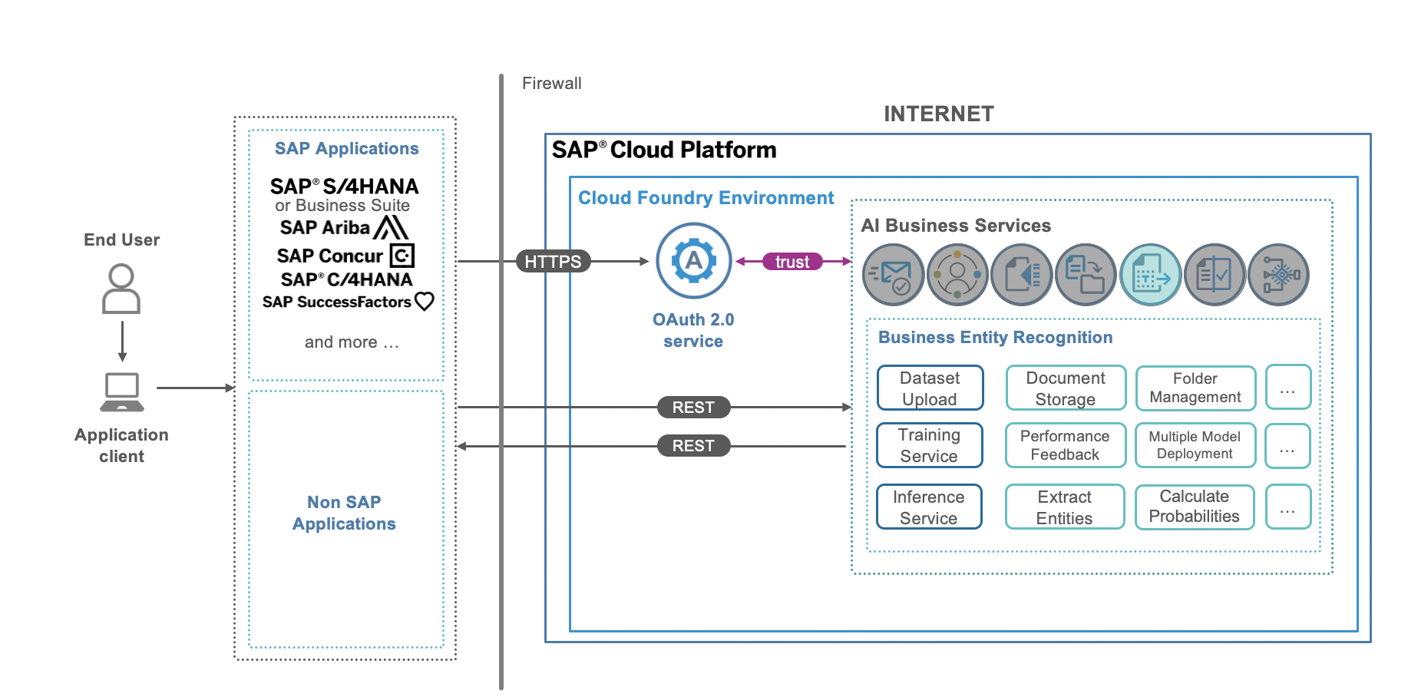
Business Entity Recognition Architecture

Slide 13
Business Entity Recognition: APIs
BER has a set of APIs to perform the following operations:
Create dataset and upload documents
Trigger training to get a custom model based on your dataset
Deploy the custom model to use it for inference
Perform inference with the deployed model to extract entities

Slide 14
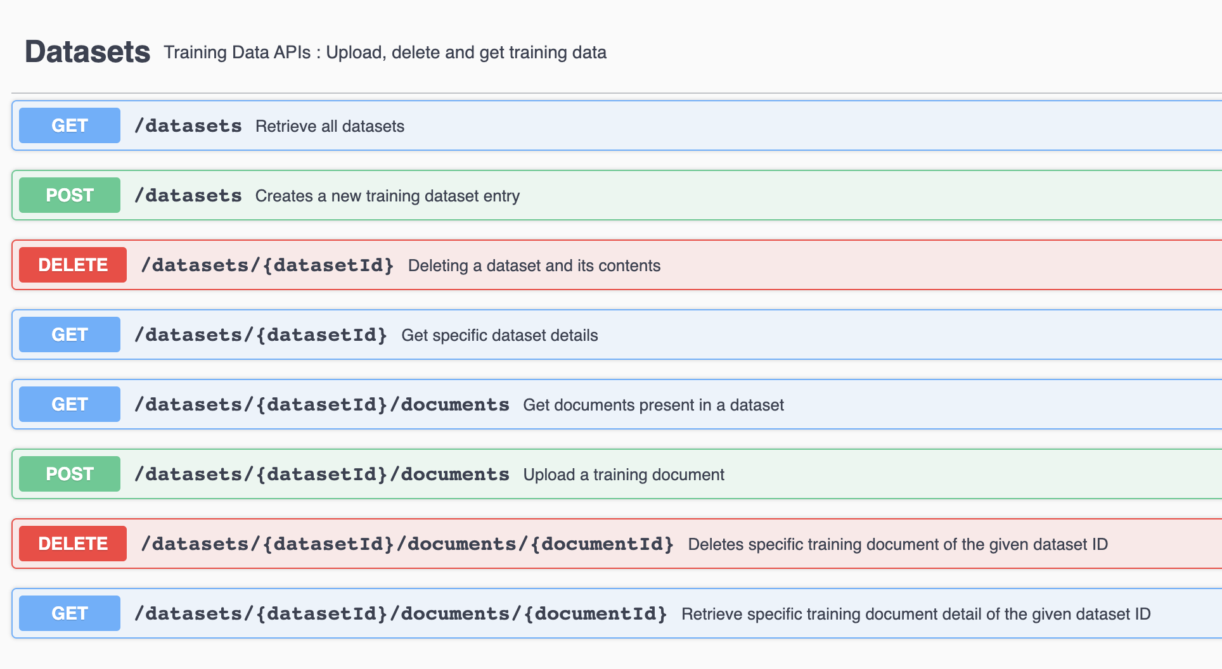
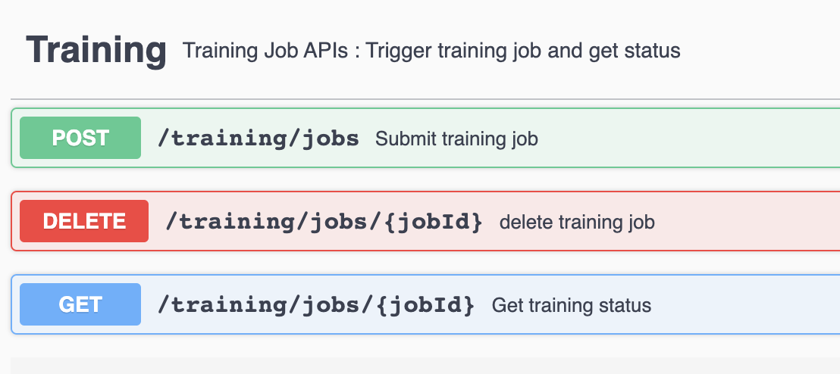
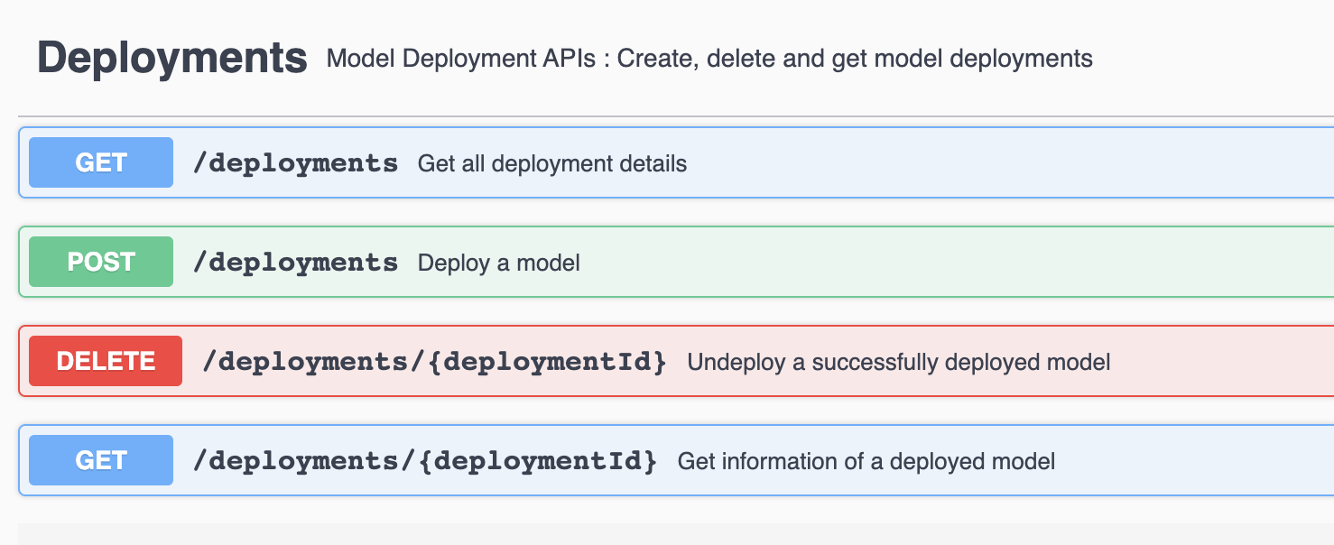
API: Trigger training to create custom models

Slide 15
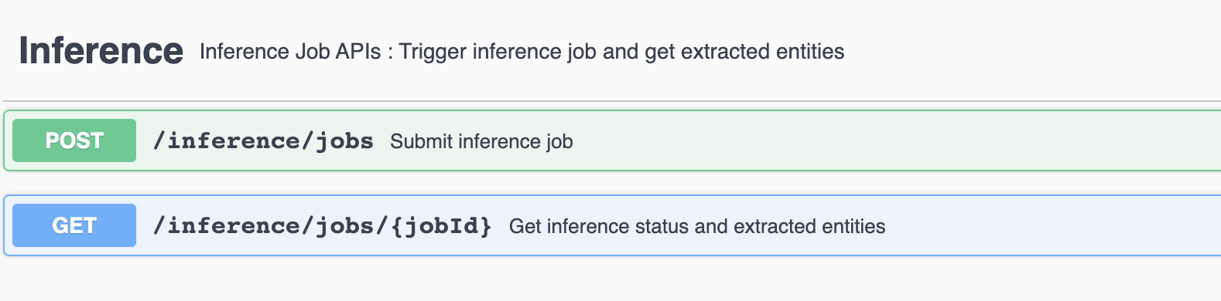
API: Inference

Slide 16






Summary
Upload Data
Train Model
Deploy Model
Prediction
Use Pre-trained models for specific business problems
Upload own entities with annotations to train a custom specific model
Train new entity models
Create model version
Get feedback on model performance
Activate trained model version
Deactivate model version when necessary
Provide data for entity recognition
Get machine learning results + confidence scores

Slide 17
Business Entity Recognition: Data Management
Training Data
Stored in Minio object storage
The data is isolated for each tenant
The service user has the full control of the data- upload and delete APIs are provided
It is recommended to use anonymization to restrict processing of PIIs by the service
Inference Data
Texts provided for inference are temporarily stored in the database (PostgreSQL)
A scheduled job runs every 24 hours to delete the texts which are older than 12 hours
Hence, no inference text would be stored for more than 24 hours

Slide 18
Business Entity Recognition: Machine Learning Process
Data pre-processing
Model Training
Model Selection
Validate training data format
Validate annotated labels
Split the dataset to train and test dataset
Deep Learning applied to Natural Language Processing
Basic components: convolutional and recurrent neural networks
Transfer learning capability:
Pretrained language models
(Denoising Auto-Encoder)
Word embeddings
Support extension to multilingual data (through language specific embedding)
Multiple models generated
Each model validated on the test dataset
Select model with best f1-score averaging across label classes

Slide 19
Demo
Locating and Classifying Named Entities in Unstructured Text

Slide 20

More information
Related SAP TechEd sessions
INT110– Learn how to Consume AI Business Services for Business Document Processing INT201– Infuse Intelligence into Business Processes with SAP AI Business Services INT820– Road Map: SAP AI Business Services INT937– Expert Q&A
Public SAP Web sites
SAP Community: https://community.sap.com/topics/artificial-intelligence SAP Help Page: https://help.sap.com/viewer/product/Business_Entity_Recognition

Slide 21


Continue your learning experience from SAP TechEd in 2020 Your exclusive path to build and maintain SAP solution skills anytime, any place
Your benefits
Gain insight into the latest innovations, and master software proficiency
Keep skills up-to-date, and enable performance and business success with help from SAP solution experts
Achieve competitive advantages and digital transformation success with trusted certifications
Get empowered with access to relevant, up-to-date digital learning for SAP TechEd participants through a complete enablement solution that drives adoption and innovation.
Deepen your learning experience from SAP TechEd
Activate your free access to SAP Learning Hub, event edition, for:
Learning Journey illustrations to guide you through complementary self-paced learning content
Content specific to SAP TechEd in the online SAP Learning Room for SAP TechEd
Access to SAP experts in special live sessions
500,000+
Learners in SAP Learning Hub
Deepen and validate your SAP solution skills
Subscribe to SAP Learning Hub, solution editions, for:
Solution-specific Learning Journey guides, content, collaborative learning, and hands-on practice for your role and goals
Drive performance and business success with validated solution expertise from the SAP Global Certification program
100+
Experts getting certified per day
150+
SAP Global Certifications
Notes:
The SAP Learning Hub platform provides exactly that
Unlimited access to all of our content, always up to date, over 3000 titles in multiple languages
Unlimited access to SAP Learning Rooms, which provide structured and non-structured, SAP instructor-led, social learning and collaboration where learners can get coaching and answers to their question
The exclusive right to buy access to live SAP systems on demand, like purchasing internet access in a hotel room
AND
Powerful LMS capabilities to run, manage and measure company specific enablement programs
ALL for one SINGLE 12-months subscription fee that is lower than the costs of attending ONE 3-day classroom course.

Slide 22
Komal Narsinghani
komal.narsinghani@sap.com

